Slide 1
Request Laravel

Slide 2
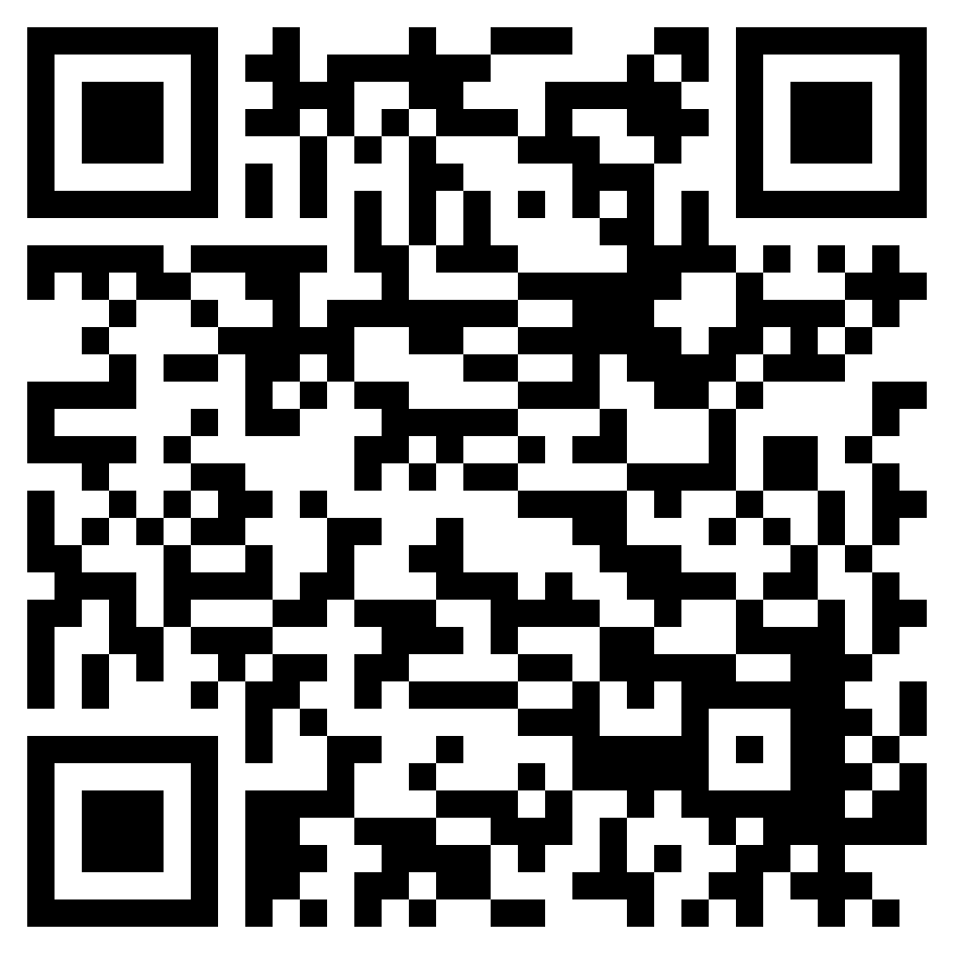
Who Am I?
Linkedin
Muhammad Ridwan Effendi - Ridwan
Project Manager at Azura Labs (2021 - Now)
1+ Years Experiences
Tester Azura Labs (2020 - 2021)
1+ Years Experiences
Runner Postman Automation
Selenium Automation
Linkedin

Slide 3
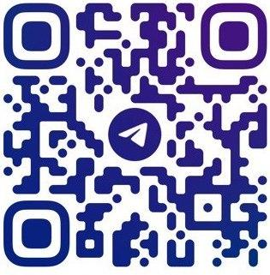
Learn with Azura

Slide 4
Outline
Kind of request in Laravel
Handling default value if the request is empty
Why we need request using validation
Implementation request using validation

Slide 5
Request
A request in Laravel is used like GET and POST in PHP
Kind of request
Retrieving Data From url
Retrieving Input

Slide 6
Retrieve Data From Url

Slide 7
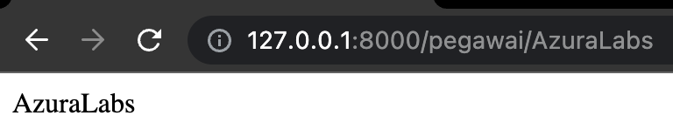
Retrieving Data From url - Flow
When we access http://127.0.0.1:8000/pegawai/AzuraLabs
We run the "show" method on the PegawaiController
In PegawaiController we capture data from route → AzuraLabs
Notes:
Note:
request-laravel → Dapat dinamai sesuai keinginan dan nama tersebut akan dibuat sebagai nama folder untuk laravel

Slide 8
Retrieving Data From url - Sample 1
Create project laravel
Open terminal
Choose folder
Run command line → composer create-project laravel/laravel request-laravel
Open project laravel in VS Code
Create DB in MAMP / XAMP
Setting DB
Open file .env
Settings according to your environments
DB_PORT → port mysql xampp: 3306, mamp: 8889
DB_DATABASE → name db in MAMP / XAMPP based on step 3
DB_USERNAME → based on username your MAMP / XAMPP
DB_PASSWORD → based on password your MAMP / XAMPP
Check connection DB using Migration → php artisan migrate
Add some code in route → directory/routes/web.php use App\Http\Controllers\PegawaiController; Route::get('/pegawai/{name}', [PegawaiController::class, 'show']);
Notes:
Note:
request-laravel → Dapat dinamai sesuai keinginan dan nama tersebut akan dibuat sebagai nama folder untuk laravel

Slide 9
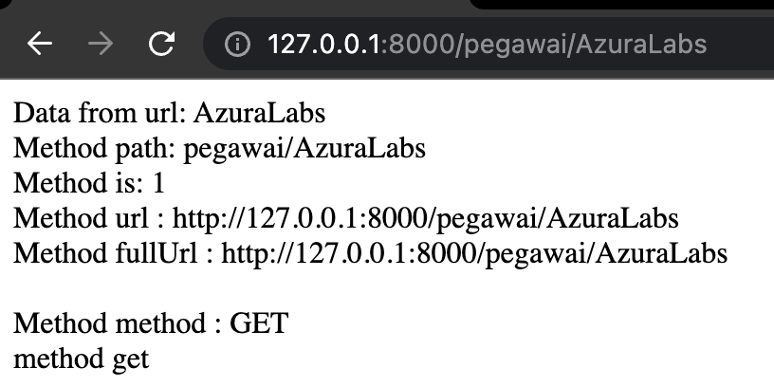
Retrieving Data From url - Sample 2
Create controller → php artisan make: controller PegawaiController
Add some code in controller → directory/app/Http/Controller/PegawaiController.php https://codefile.io/f/qcCI98mg6NhF1VJqxpp4
Run project laravel → php artisan serve
Run route in browser
localhost:8000/pegawai/AzuraLabs or
http://127.0.0.1:8000/pegawai/AzuraLabs
Notes:
Note:
request-laravel → Dapat dinamai sesuai keinginan dan nama tersebut akan dibuat sebagai nama folder untuk laravel

Slide 10
Review Some Code
Path()→ receive request path information
is()→ verify if the path matches the created pattern
To get all the incoming URL information, you can use the url() or fullUrl() methods.
Method()→ to receive HTTP verb information for request
isMethod()→ method to verify the HTTP verb is the same as the string value in logic
Notes:
Note:
request-laravel → Dapat dinamai sesuai keinginan dan nama tersebut akan dibuat sebagai nama folder untuk laravel

Slide 11
Retrieving Input

Slide 12
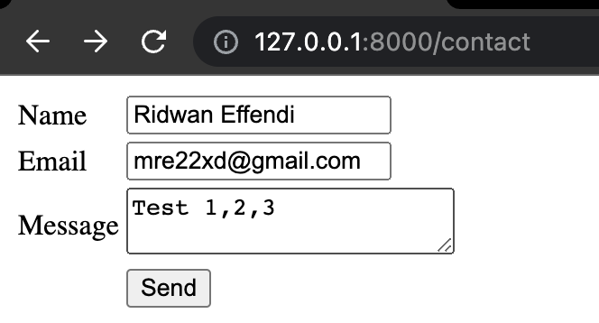
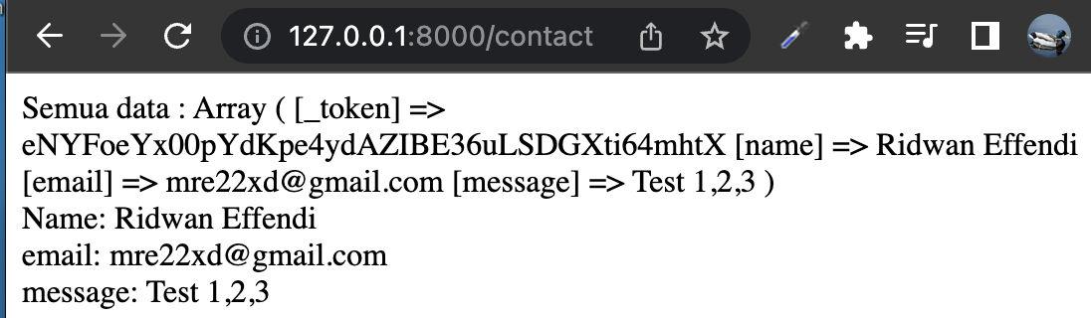
Retrieving Input - Flow
When we access http://127.0.0.1:8000/contact
We run the "index" method on the ContactController
In ContactController redirected to form page
After submitting the form, it will be directed to the “store” method which displays all the submitted data on the form page
Notes:
Note:
request-laravel → Dapat dinamai sesuai keinginan dan nama tersebut akan dibuat sebagai nama folder untuk laravel

Slide 13
Retrieving Input - Sample
Create view → directory/resources/views/contact.blade.php
Add some code in view → directory/resources/views/contact.blade.php https://codefile.io/f/tkzv5Grysa4wl9hixJ94
Create controller → php artisan make:controller ContactController
Add some code in controller → directory/app/Http/Controller/ContactController.php https://codefile.io/f/vhIJFiXMUyQ0mZQy2UQF
Add some code in route → → directory/routes/web.php use App\Http\Controllers\ContactController; Route::get('/contact', [ContactController::class, 'index']); Route::post('/contact', [ContactController::class, 'store']);
Run route in browser → http://127.0.0.1:8000/contact
Fill all the fields in the form
Submit the form
Notes:
Note:
request-laravel → Dapat dinamai sesuai keinginan dan nama tersebut akan dibuat sebagai nama folder untuk laravel

Slide 14
Review Some Code
All()→ retrieve all of the incoming request's input data as an array using the all method.
collect()→ retrieve all of the incoming request's input data as a collection.
Input()→ get the value from the form that has been filled in previously.
Get()→ get the value from the form that has been filled in previously.
$request->message → get the value from the form that has been filled in previously (field message)
Notes:
Note:
request-laravel → Dapat dinamai sesuai keinginan dan nama tersebut akan dibuat sebagai nama folder untuk laravel

Slide 15
Trouble is coming

Slide 16
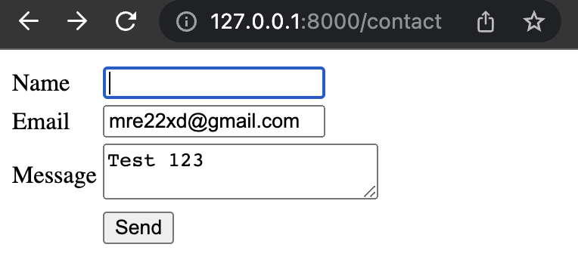
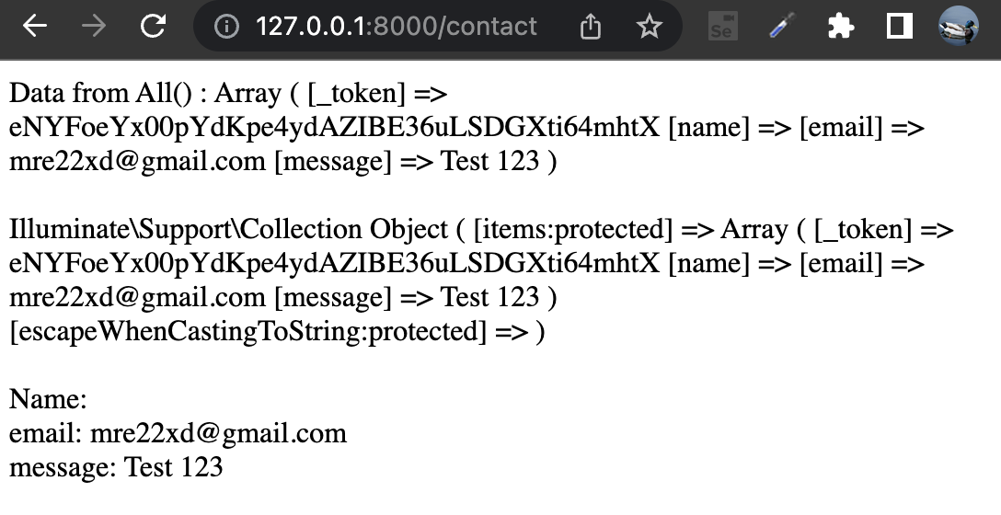
When field is empty?
Notes:
Note:
request-laravel → Dapat dinamai sesuai keinginan dan nama tersebut akan dibuat sebagai nama folder untuk laravel

Slide 17
Solution #1 Handling default value if the request is empty

Slide 18
Handling default value if the request is empty
When the field is empty, then we can fill it with the default value
When the field is filled, then we use the value based on our input and ignore the default value
Notes:
Note:
request-laravel → Dapat dinamai sesuai keinginan dan nama tersebut akan dibuat sebagai nama folder untuk laravel

Slide 19
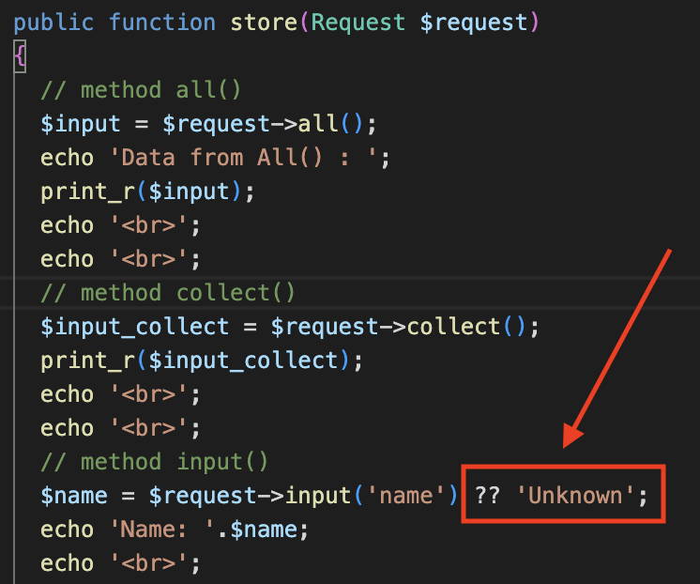
Handling default value if the request is empty - sample
Add some code in controller → directory/app/Http/Controller/ContactController.php ?? 'Unknown';
Run route in browser → http://127.0.0.1:8000/contact
Leave the name field empty
Submit the form
Notes:
Note:
request-laravel → Dapat dinamai sesuai keinginan dan nama tersebut akan dibuat sebagai nama folder untuk laravel

Slide 20
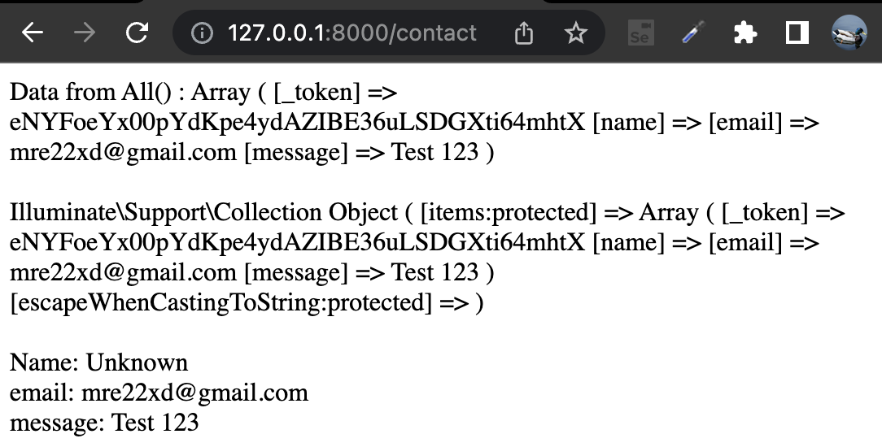
Now, name not empty again :)
Notes:
Note:
request-laravel → Dapat dinamai sesuai keinginan dan nama tersebut akan dibuat sebagai nama folder untuk laravel

Slide 21
Solution #2 Form Validation

Slide 22
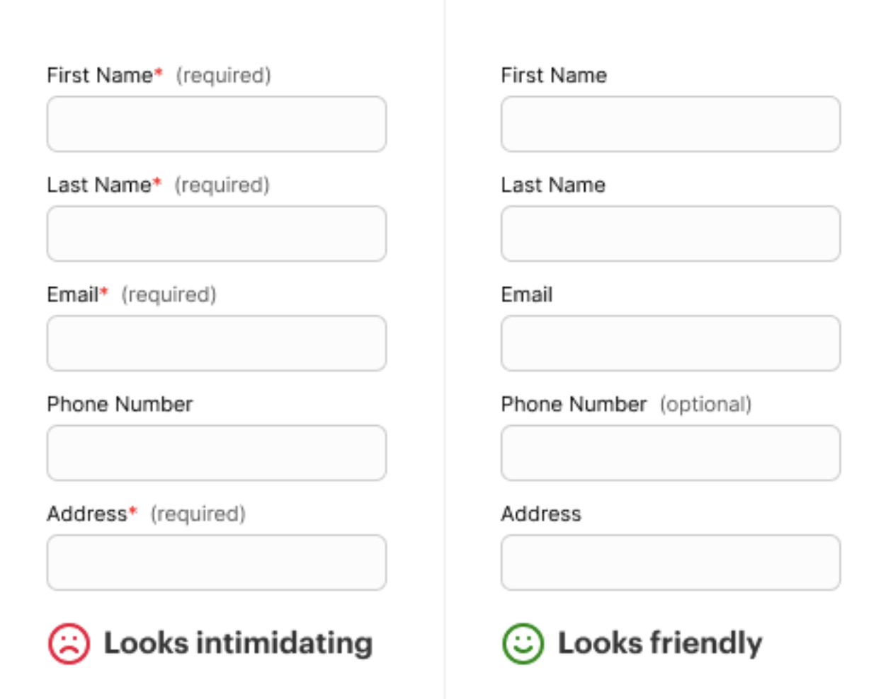
Form Validation
When a user forgets to fill in a column, a warning needs to be given. Which column has not been filled in
Notes:
Note:
request-laravel → Dapat dinamai sesuai keinginan dan nama tersebut akan dibuat sebagai nama folder untuk laravel

Slide 23
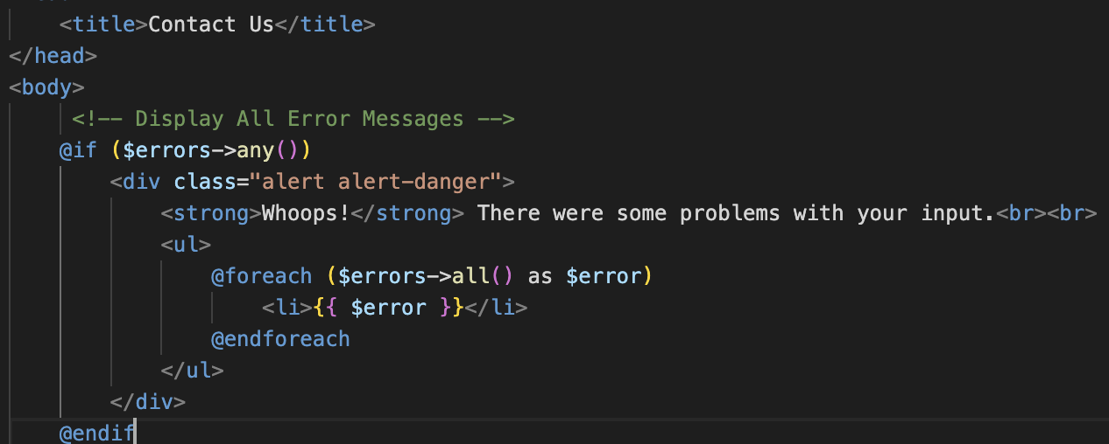
Form Validation - Sample
Add some code in view → directory/resources/views/contact.blade.php https://codefile.io/f/1OXJ34TCg7WR8ePG7xpR
Comment all code before (ContactController.php - store) → directory/app/Http/Controller/ContactController.php
Add some code in controller (ContactController.php - store) → directory/app/Http/Controller/ContactController.php https://codefile.io/f/KcICwQMyQfMTgGctwwGC
Run route in browser → http://127.0.0.1:8000/contact
Leave the name field empty
Submit the form
Notes:
Note:
request-laravel → Dapat dinamai sesuai keinginan dan nama tersebut akan dibuat sebagai nama folder untuk laravel

Slide 24
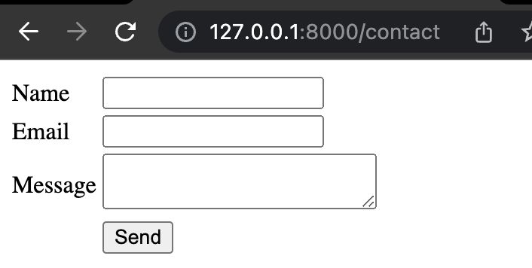
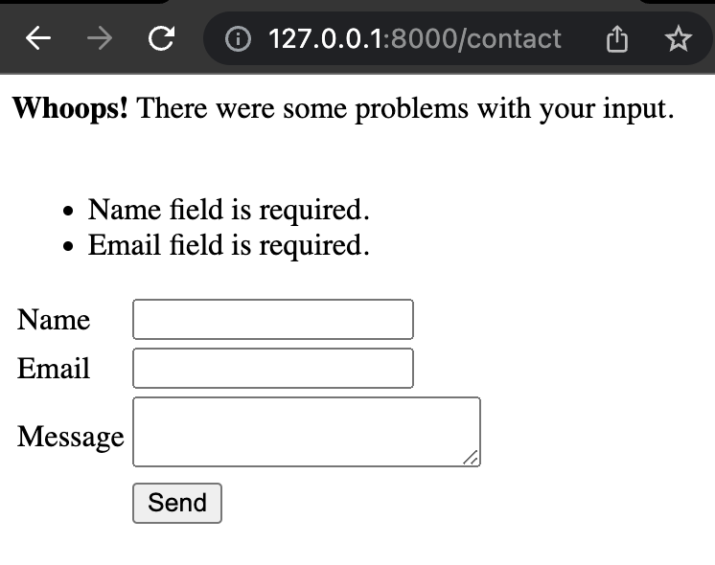
Now, user know where
Notes:
Note:
request-laravel → Dapat dinamai sesuai keinginan dan nama tersebut akan dibuat sebagai nama folder untuk laravel

Slide 25
Review Some Code
Notes:
Note:
request-laravel → Dapat dinamai sesuai keinginan dan nama tersebut akan dibuat sebagai nama folder untuk laravel

Slide 26
Homework - Coming Soon
Spoiler…..
Complete the previous task
Implementation validation form
Implementation handling request file

Slide 27
References
https://laravel.com/docs/9.x/requests
https://www.tutorialspoint.com/laravel/laravel_request.htm
https://www.malasngoding.com/request-data-pada-laravel/
https://medium.com/dotlocal/belajar-laravel-chapter-14-tutorial-http-requests-e480add2acb8
https://laravel.com/docs/9.x/collections
Notes:
In the example above, notice that we did not have to tell PHP which data type the variable is.
PHP automatically converts the variable to the correct data type, depending on its value.

Slide 28
Thanks!
Do you have any questions?

Slide 29
More Information
Opportunity:
Bootcamp
Internship
Part-time
Full-time
Follow IG Azura → azuralabs.id https://www.instagram.com/azuralabs.id/
Follow Linkedin Azura Labs → azuralabs.id https://www.linkedin.com/company/azuralabsid/mycompany/
Blog Azura https://blog.azuralabs.id/

Slide 30
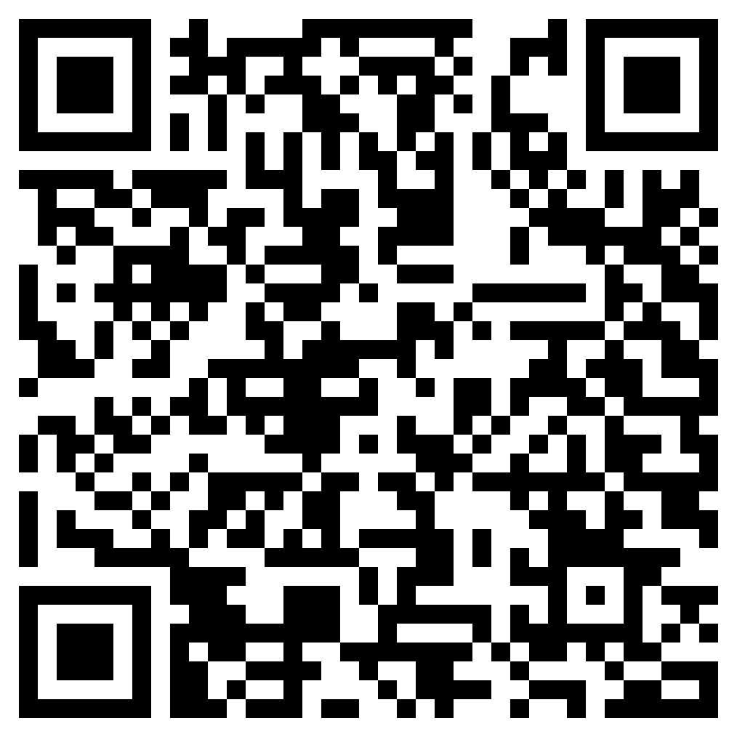
Absen & Feedback

Slide 31
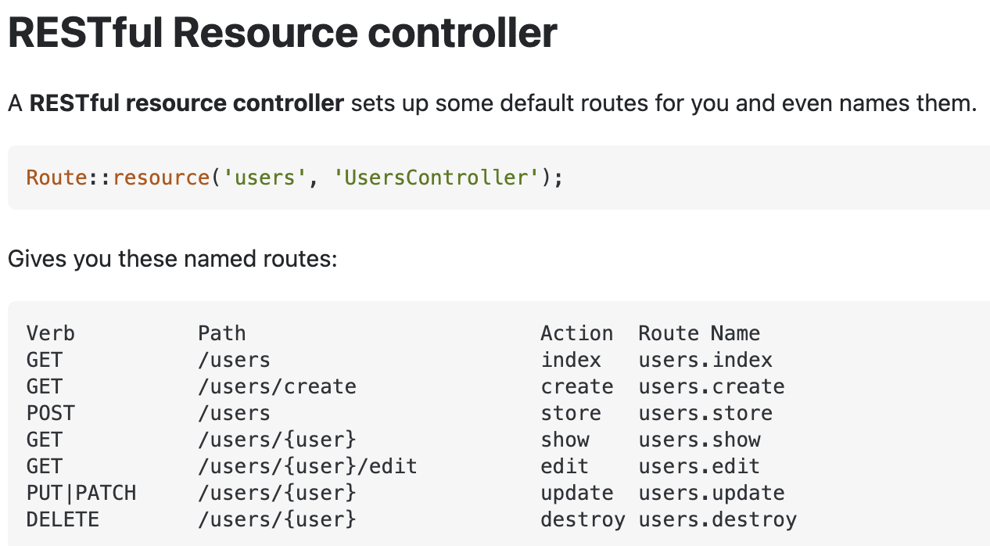
Tips
Autocomplete Extensions - PHP Intelephense
Restful Standard

